Slide 1
Use of 1D Array: Linear Search and Bubble Sort

Slide 2
Objectives
To learn and appreciate the following concepts
Searching Technique
Linear Search

Slide 3
Arrays – A recap
1D Array:
Syntax: type array_name[size];
Initialization:
type array-name [size]={list of values}
Read: Write:
for(i=0;i<n;i++) for(i=0;i<n;i++)
scanf(“%d”,&a[i]); printf(“%d”,a[i]);

Slide 4
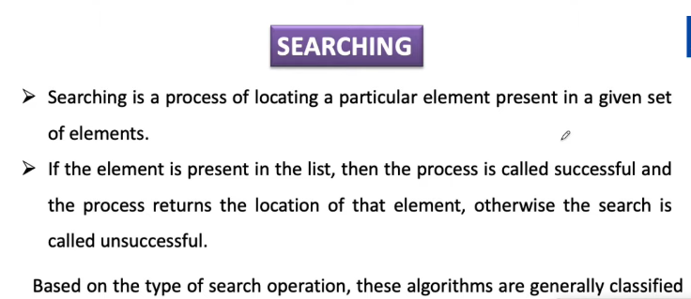


Slide 5
Searching
Finding whether a data item is present in a set of items
linear search / sequential search
Notes:
In computer science, linear search or sequential search is a method for finding a particular value in a list, which consists of checking every one of its elements, one at a time and in sequence, until the desired one is found.
Linear search is the simplest search algorithm.
classifications: linear search / binary search based on how the search is performed

Slide 6
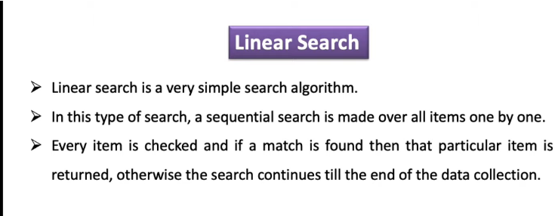
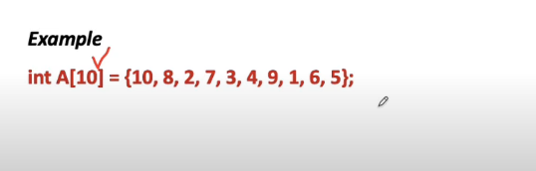

Slide 7
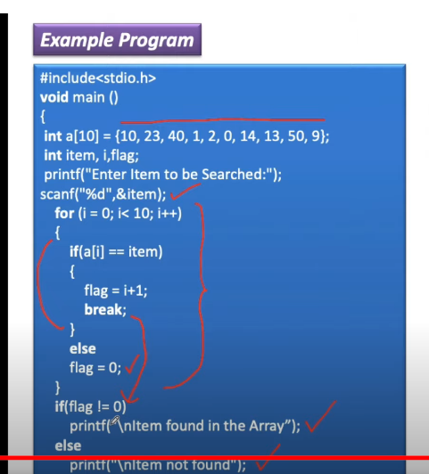
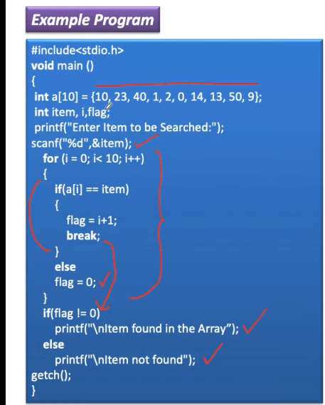
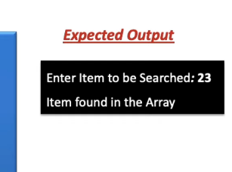

Slide 8
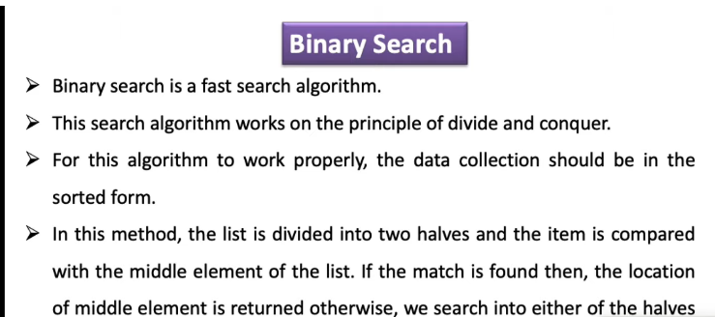

Slide 9
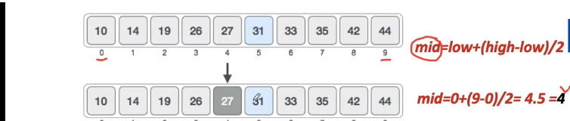
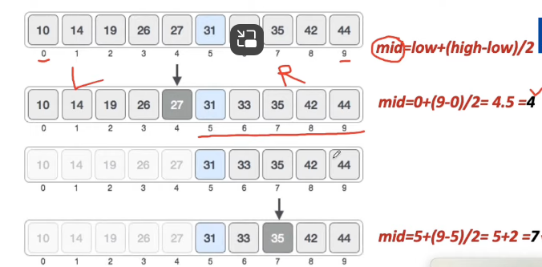

Slide 10
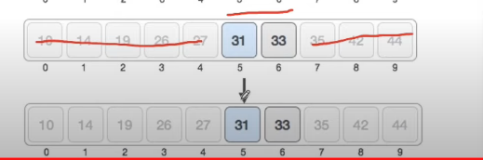

Slide 11
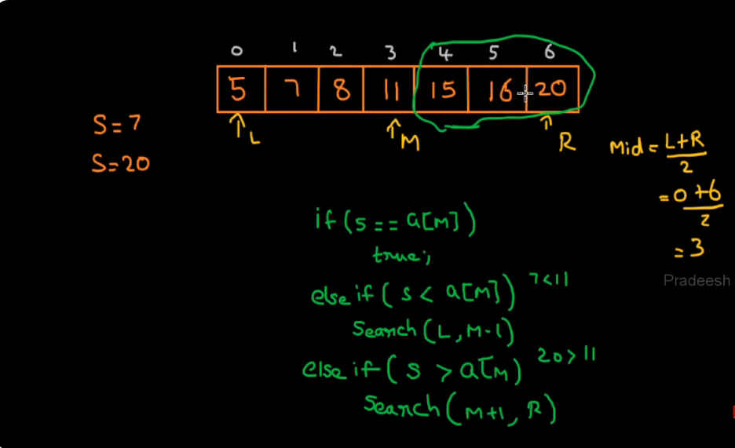

Slide 12
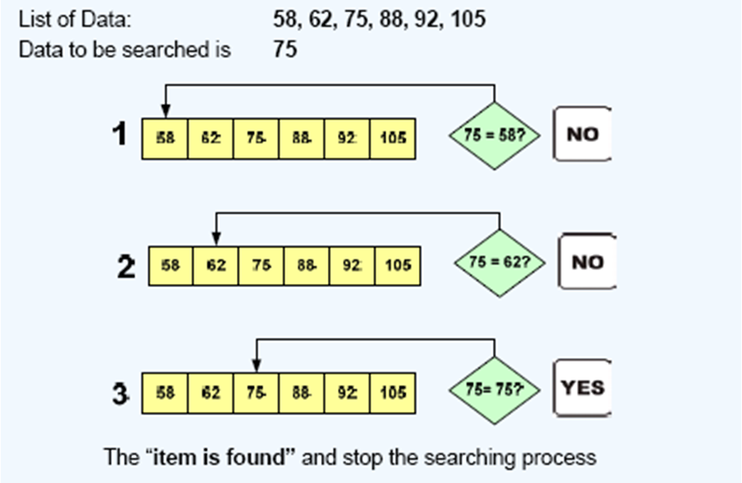
Linear search- illustration 1
Notes:
The Linear Search is applied on the set of items that are
not arranged in any particular order
In linear search , the searching process starts from the
first item.
The searching is continued till either the item is found or
the end of the list is reached indicating that the item is
not found.
The items in the list are assumed to be unique.

Slide 13
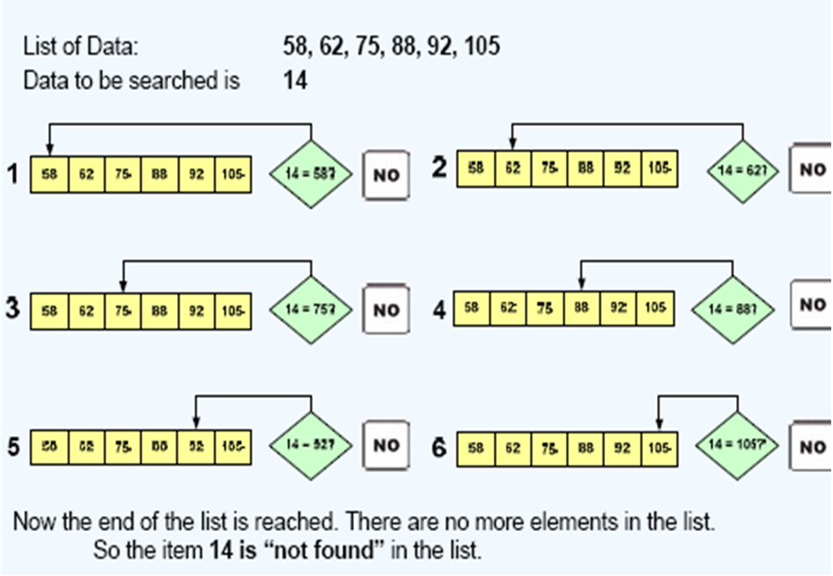
Linear search- illustration 2
Notes:
The Linear Search is applied on the set of items that are
not arranged in any particular order
In linear search , the searching process starts from the
first item.
The searching is continued till either the item is found or
the end of the list is reached indicating that the item is
not found.
The items in the list are assumed to be unique.

Slide 14
Pseudo code for linear search
int found=0; //setting flag
Print "enter no of numbers";
Input n;
for(i=0;i<n;i++){
Print “enter number\n";
Input a[i]; // entered data items
}
Print “enter the element to be searched";
Input key; // data to be searched
/*search procedure*/
for(i=0; i<n; i++) {
if(a[ i ]==key) // comparison
{
found=1;
pos=i+1;
break;
} }
if(found==1)
Print“data_found_in”,pos,
"position";
otherwise
Print “data is not found“;

Slide 15
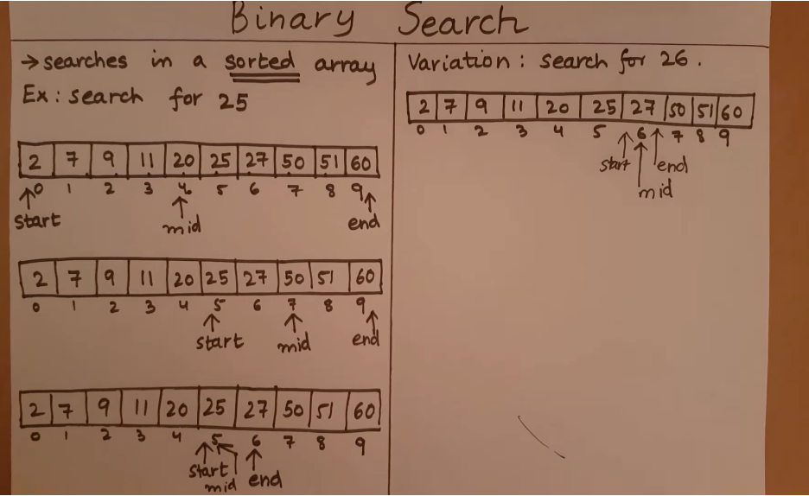

Slide 16
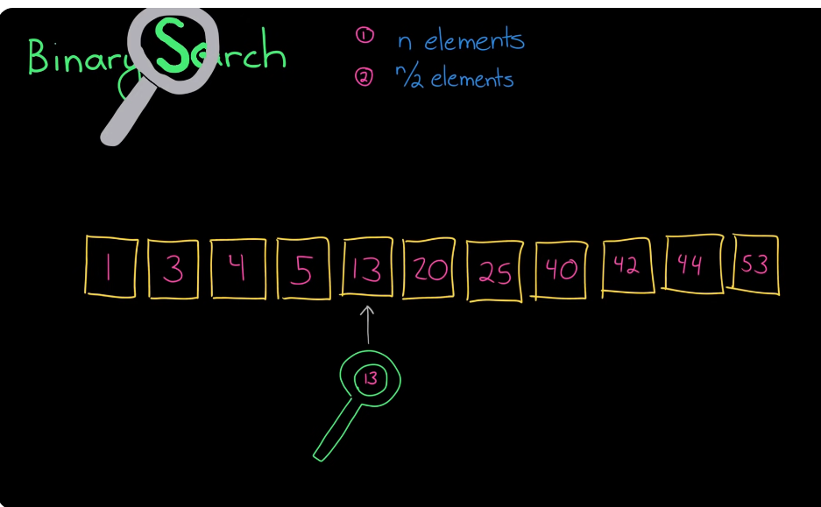

Slide 17
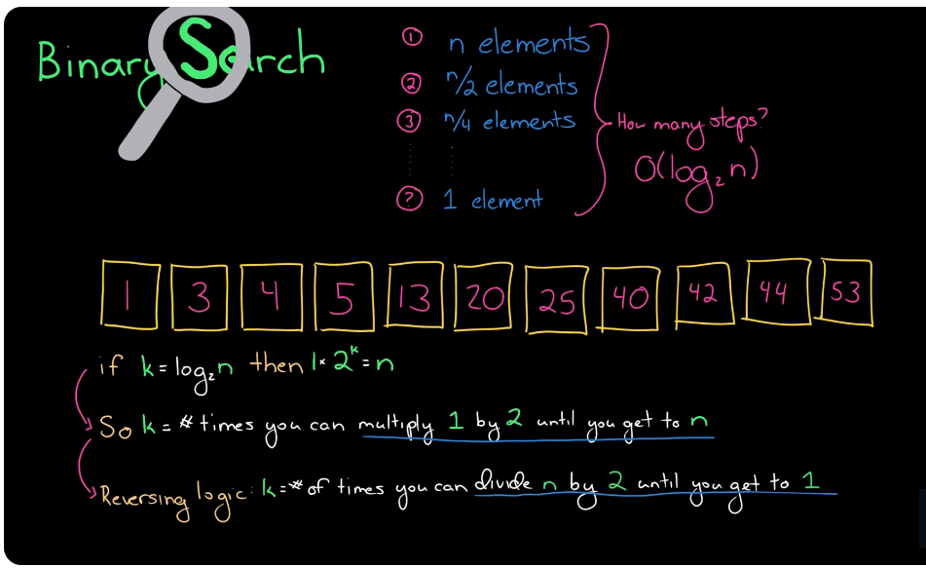

Slide 18
Sorting Techniques L17-L18
Notes:
Bubble sort, sometimes referred to as sinking sort/ripple sort, is a simple sorting algorithm that works by repeatedly stepping through the list to be sorted, comparing each pair of adjacent items and swapping them if they are in the wrong order.

Slide 19
Objectives
To learn and appreciate the following concepts
Sorting Technique
Bubble Sort

Slide 20
Sorting
Arrangement of data elements in a particular order
Bubble sorting
Notes:
Bubble sort, sometimes referred to as sinking sort/ripple sort, is a simple sorting algorithm that works by repeatedly stepping through the list to be sorted, comparing each pair of adjacent items and swapping them if they are in the wrong order.

Slide 21
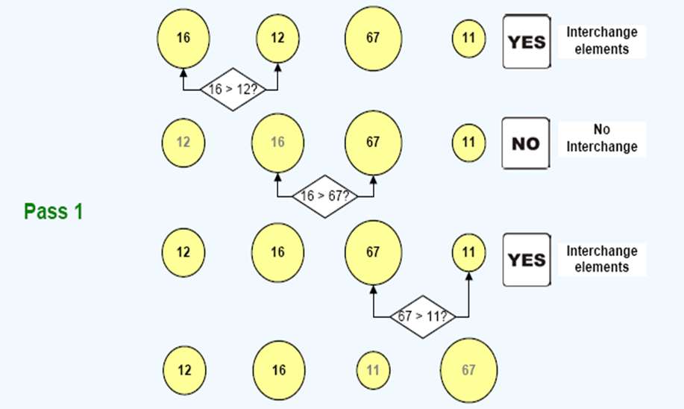
Bubble Sort- Illustration

Slide 22
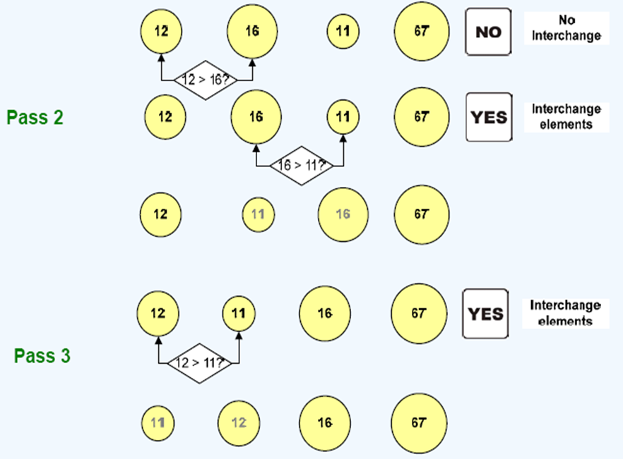
Bubble Sort- Illustration

Slide 23
Pseudo code for Bubble Sort procedure
for(i=0;i<n;i++)
Input a[i]; // entered elements
for(i=0;i<n-1;i++) //pass
{ for(j=0;j<n-i-1;j++)
{ if(a[j]>a[j+1]) // comparison
{ // interchange
temp=a[j];
a[j]=a[j+1];
a[j+1]=temp;
}
}
}
Example :
a[ ]={16, 12, 11, 67}
Array after sorting (ascending) a[ ]={11, 12, 16, 67}

